Slide 1

Progress Presentation
AI Content moderation system
Leela Sai raparla, Nikhil Vishwanath, Rishabh Nair, Prince Rusweka Rwabongoya

Slide 2
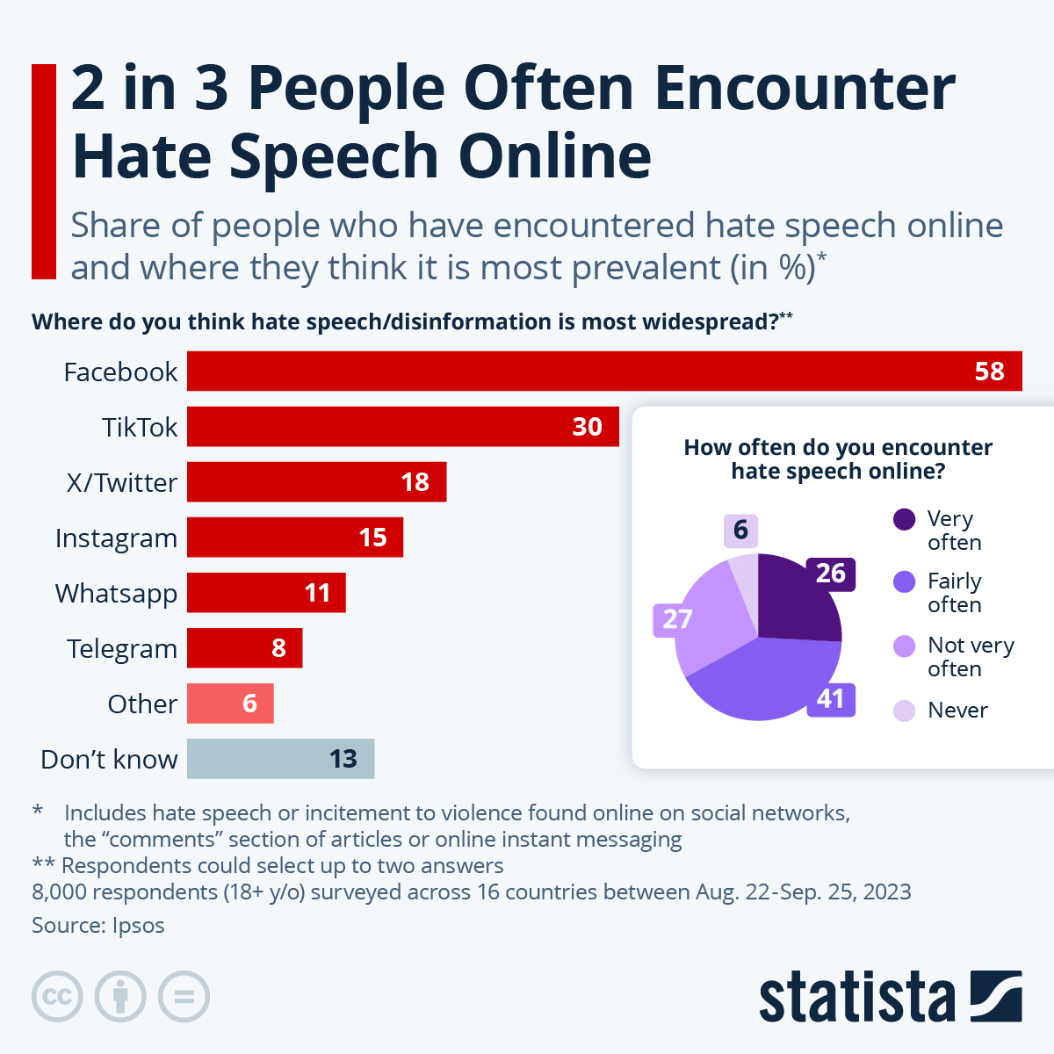
Motivation/Objective
The objective of this project is to develop an AI-powered content moderation system that accurately classifies text into two categories: Hate Speech and Not Hate Speech.

Slide 3
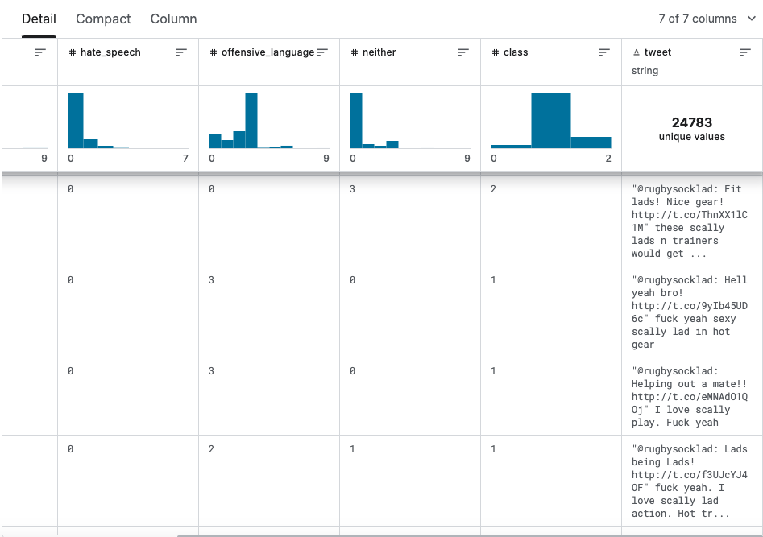
Kaggle Hate Speech Data Set
3 Categories
Hate Speech
Expresses hate towards a specific group
Offensive Language
Profane or abusive language
Does not target a particular group
Neutral Content
Non-offensive language

Slide 4
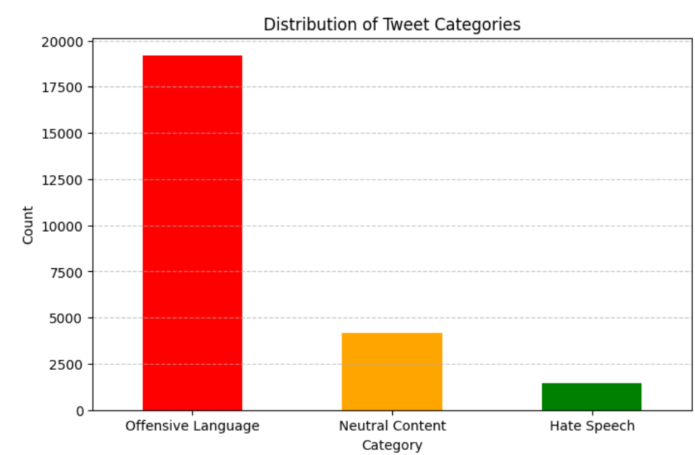
Data Visualizations
The dataset is imbalanced, with most tweets labeled as offensive language (class 1).
Hate speech (class 0) is less frequent.
Neutral content (class 2) is the least common category.

Slide 5
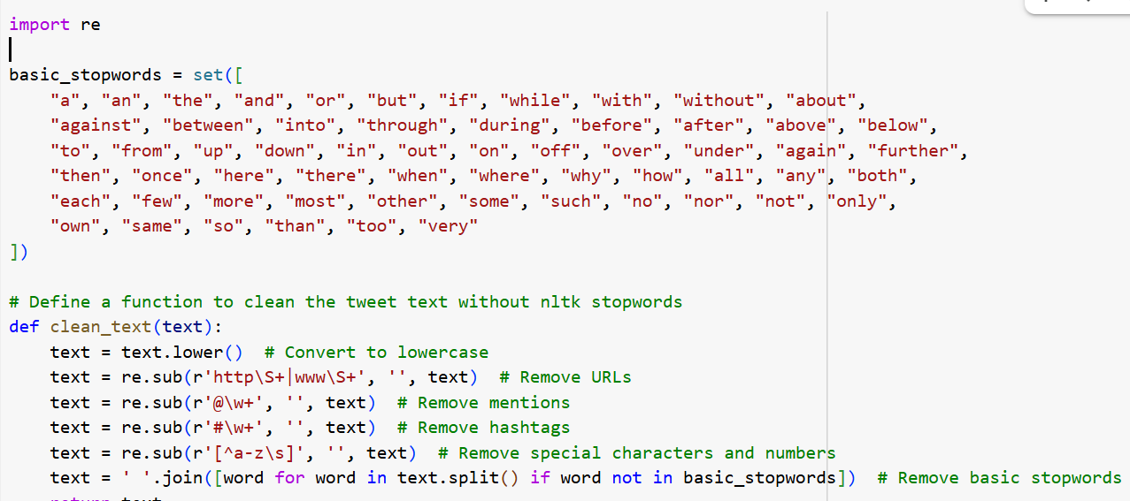
Data Preprocessing
Removing URLs, mentions, hashtags, special characters, and common stopwords.

Slide 6
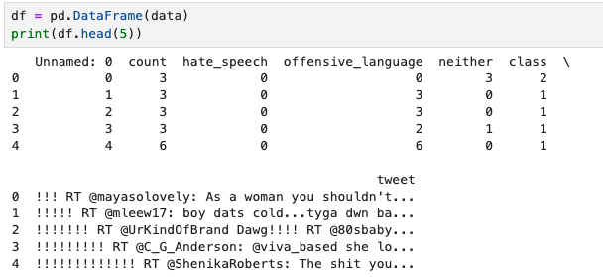
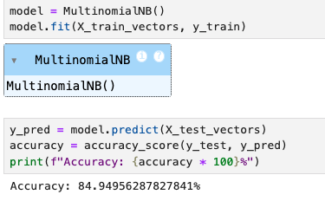
AI Model: Naïve Bayes
https://www.geeksforgeeks.org/multinomial-naive-bayes/

Slide 7
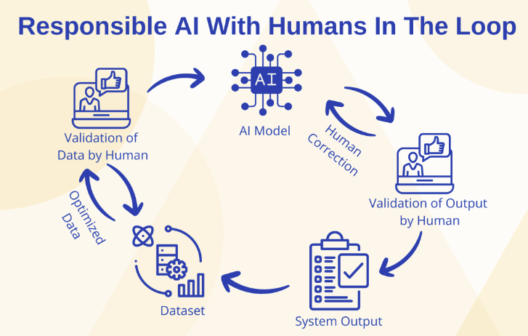
Ethical Implications
Bias detection
Potential disproportionate flagging in language of certain communities/groups
Mitigation strategy: bias audit (evaluation of the data set to identify biases) + threshold adjustments (modifying classification threshold based on attributes like race/gender)
False positive/negatives + incorrect flagging of non-hateful tweets
Lead to false censorship of non-hateful tweets / hateful tweets can bypass moderation (disguised language)
Mitigation strategy: human-in-the loop review (human involvement in the AI system to accurately review AI content flags/decisions)
Reflection: Accuracy vs. Inclusivity
Strict moderation → less hate speech, over censorship
Lenient moderation → free speech, risk of harmful content bypassing
https://www.titanml.co/glossary/human-in-the-loop

Slide 8

Potential Improvements to Model
Diverse & Balanced Data – Ensure training data represents different dialects, cultures, and contexts.
Context-Aware Features – Use n-grams and word embeddings to capture meaning beyond single words.
Hybrid Model Approach – Combine Naïve Bayes with deep learning (e.g., BERT, LSTMs) for better accuracy.
Bias Detection & Fairness Checks – Regularly audit model predictions to ensure fair treatment across groups.
Human-AI Collaboration – Use AI to flag content, but let human moderators review complex cases.
https://www.scientificamerican.com/article/humans-absorb-bias-from-ai-and-keep-it-after-they-stop-using-the-algorithm/

Slide 9

Plan to Finish Project
Data Collection & Preprocessing – Choose a dataset, clean the text, and convert it into numerical features using CountVectorizer or TfidfVectorizer.
Model Training & Evaluation – Train a Naïve Bayes, split the data, and evaluate using accuracy, precision, recall, and F1-score.
Bias & Ethical Analysis – Examine whether the model disproportionately flags certain groups, analyze dataset fairness, and propose improvements.
Visualization & Reporting – Create performance visualizations and summarize findings in a report
Presentation Preparation – Develop slides with key insights on model performance, bias, and ethical considerations for the final presentation

Slide 10

Thank You Any Questions?

